Slide 1
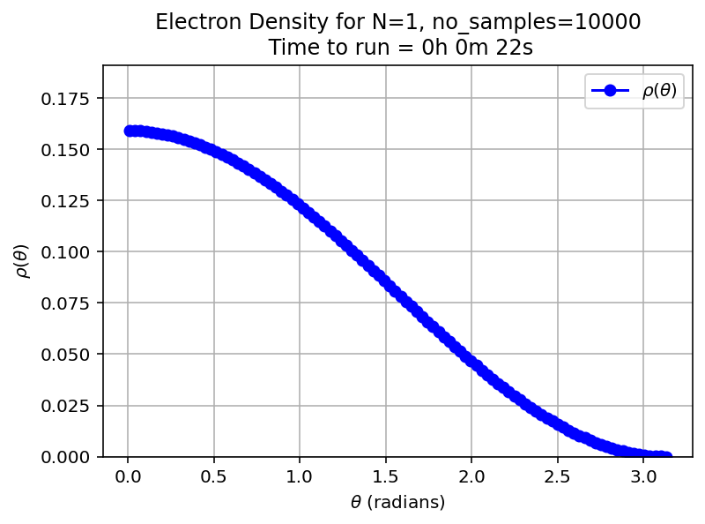
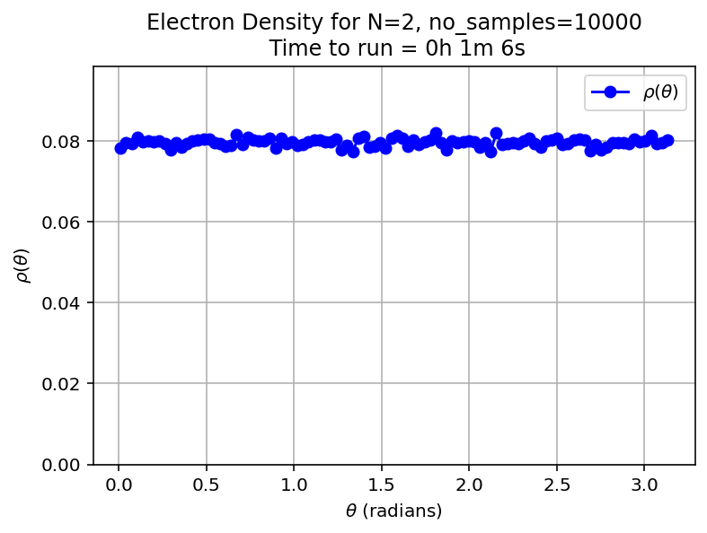
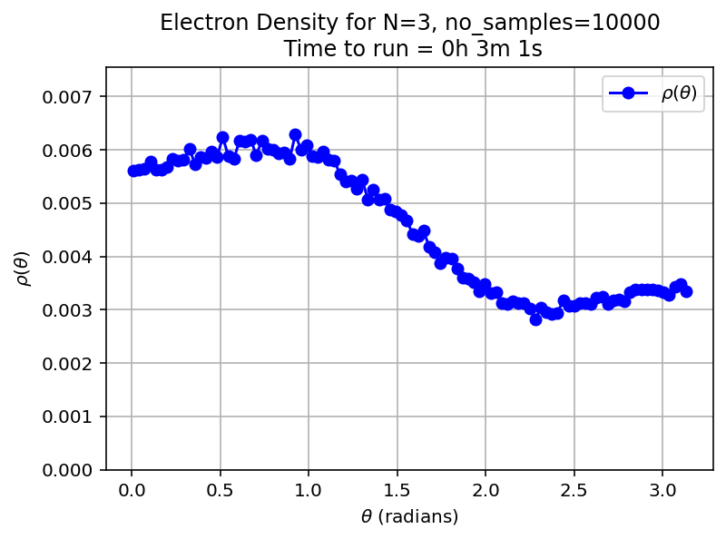
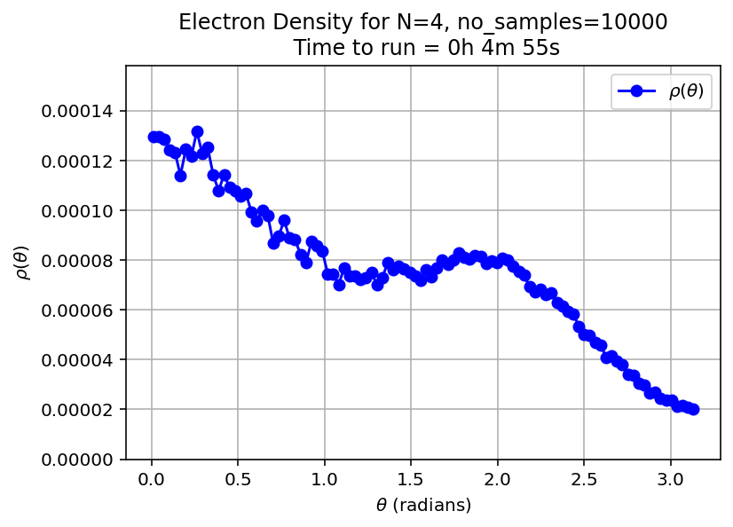
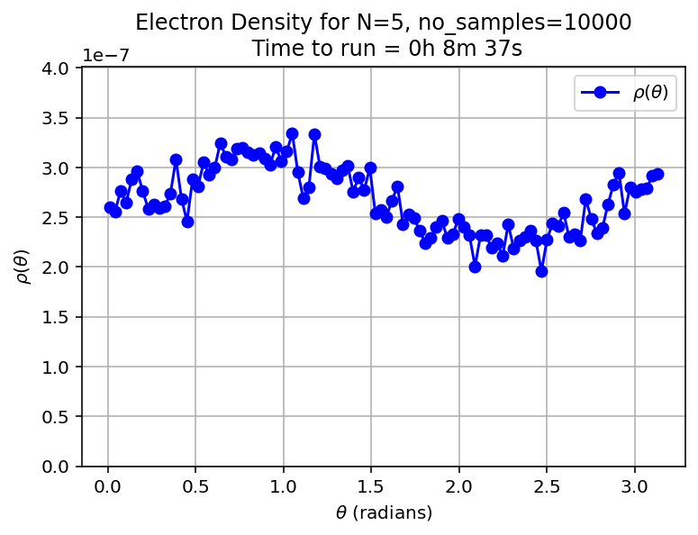
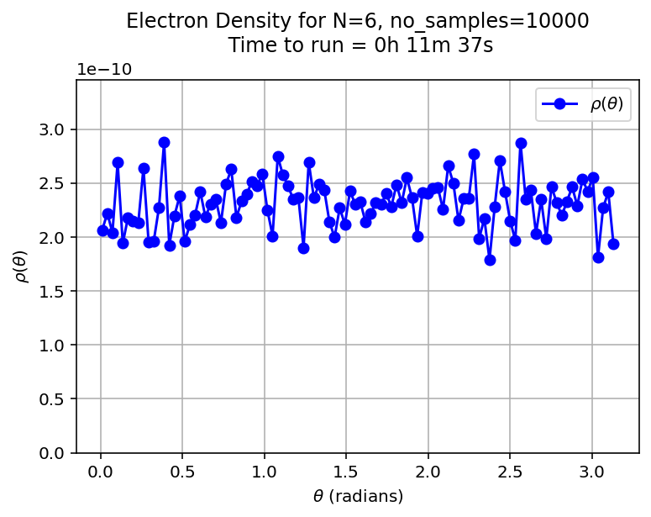
Electron density at nu=1/2 on a sphere calculated with Monte Carlo Monte Carlo
22/08/2025
Aim of these plots: work out if I’ve correctly implemented the wavefunction. Are these results reasonable/correct?
Note 2: The normalisations don’t seem correct
Note 3: As expected, N=2 and N=6 (fully filled LLs) are uniform, and as N increases between LLs, the north pole is more dense (Hund’s rules)
Note 1: Hund’s rules are used for the partially filled LLs

